Slide 1

Developing Marketing Data for Analysis

Slide 2
Objective :
Read and changed Data types
Joined and merged tables
Final Result
Generated BASIC Statistics for each table
Validated each table for accuracy

Slide 3

Introduction :
To analyze marketing trend right data and accurate records plays a vital role. Understanding customers behavior, needs, style of purchase helps in marketing strategies and target audience.
Customer, Product and Transaction data can be used to track customer history and future purchasing and can identify most repeated customers and sales by Customers ID’s(Unique identification) with purchasing records.
Customer segmentation based on demographics, customer behavior and business requirements can offer customized services to provider by their satisfaction.
To ensure that marketing efforts are backed by certain trends rather than assumptions analyzing marketing data can have benefits for data-driven decision making, segmentation and marketing, campaigns, budget allocation, real-time monitoring and improve customer experience.
This analysis can be a great turn over for ROI can lead to higher conversion rates and customer retention.
Predictive analytics can boost businesses to focus on future trends by optimizing stock levels and can reduce wastage.

Slide 4
Methodology :
Step 1: Import tables in SQL through Wizard
Step 2: Performed exploratory data analysis(Count, min, max)
Step 3: Designed desired table structure
Step 4: Mapped relationship between Transaction with Product Data and than Transaction with Customer Data
Step 5: Validated each steps for accuracy
Step 6: Marged the joined tables for Final Result

Slide 5
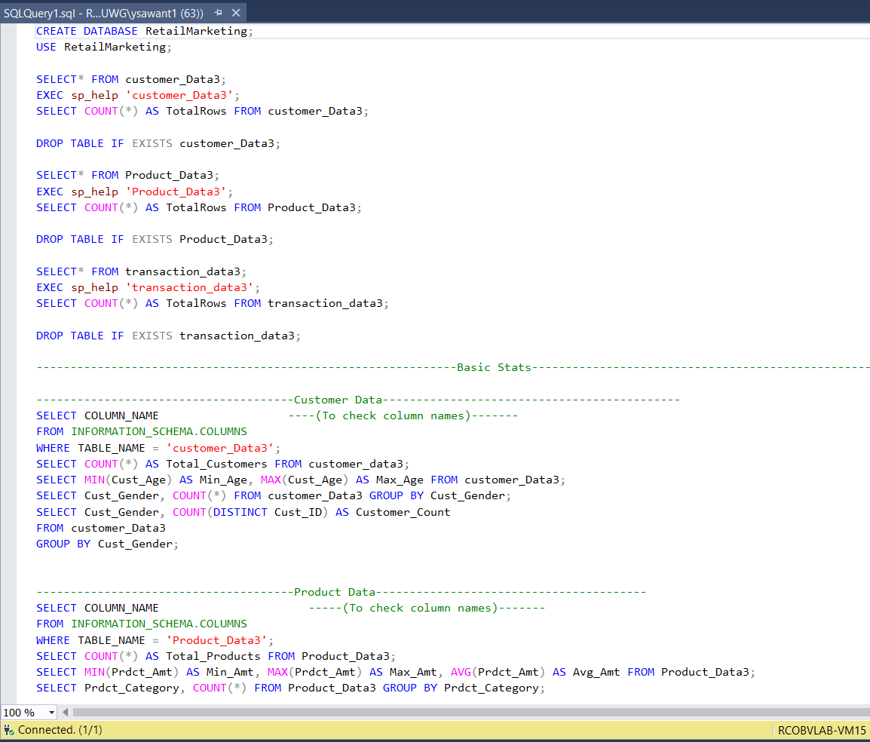
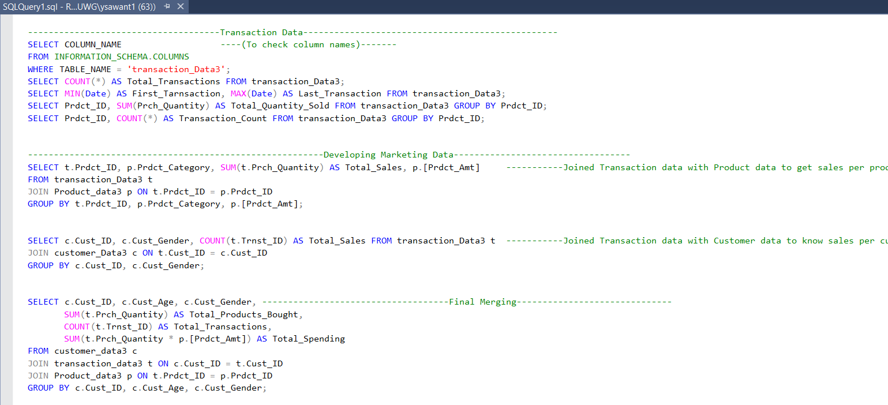
Code :

Slide 6
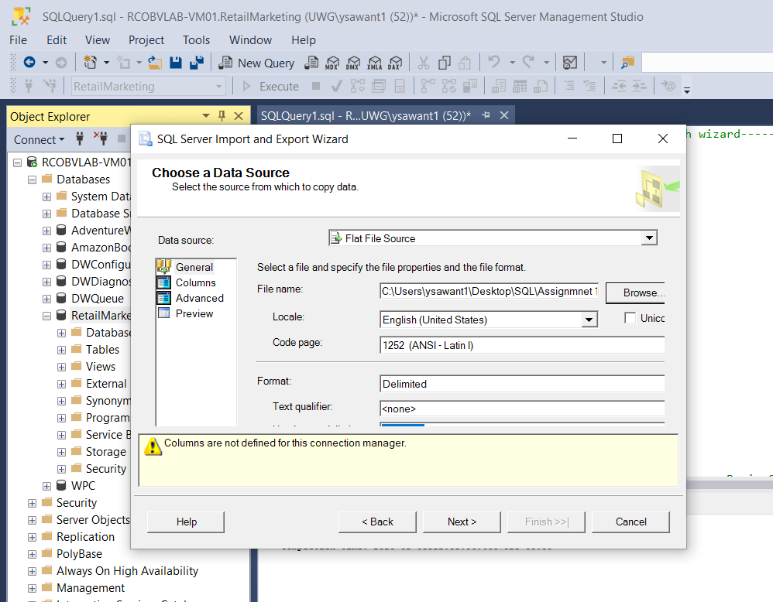
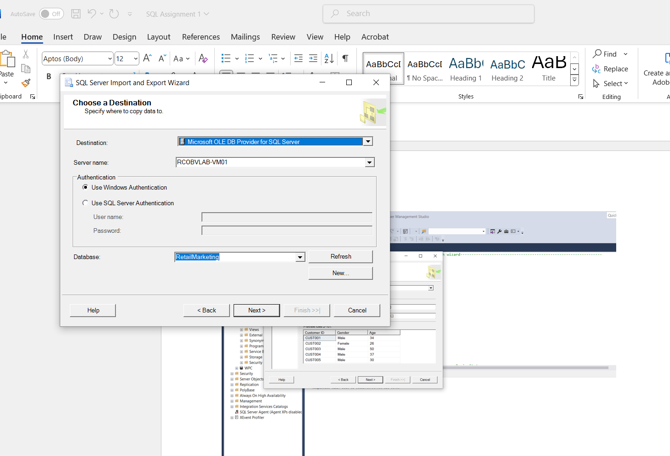
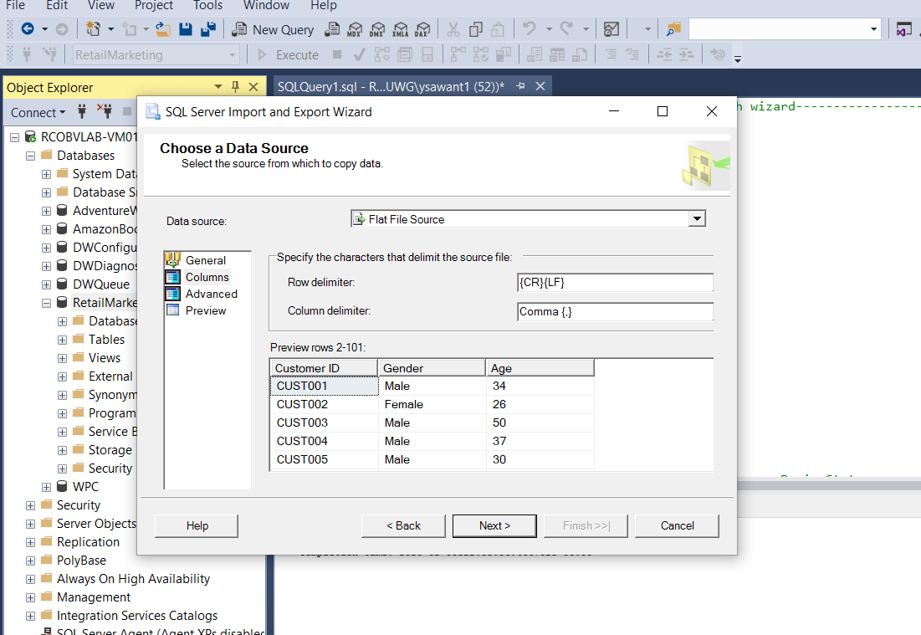
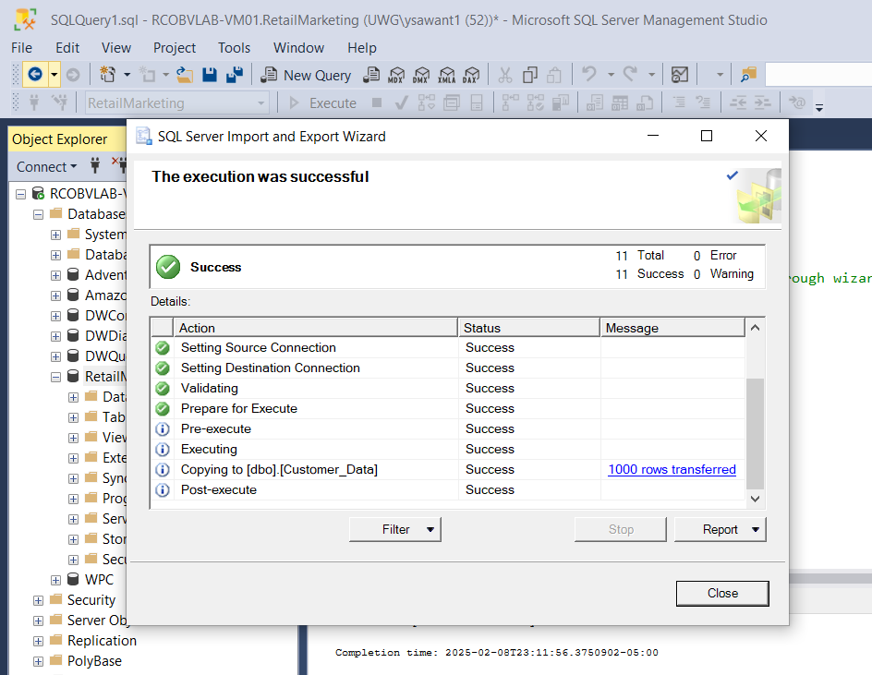
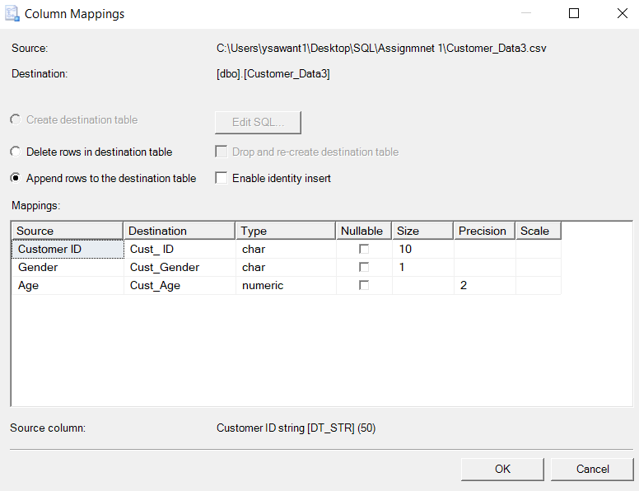
Output : Read table in SQL for Customer, Transaction and Product using same steps with different data types

Slide 7
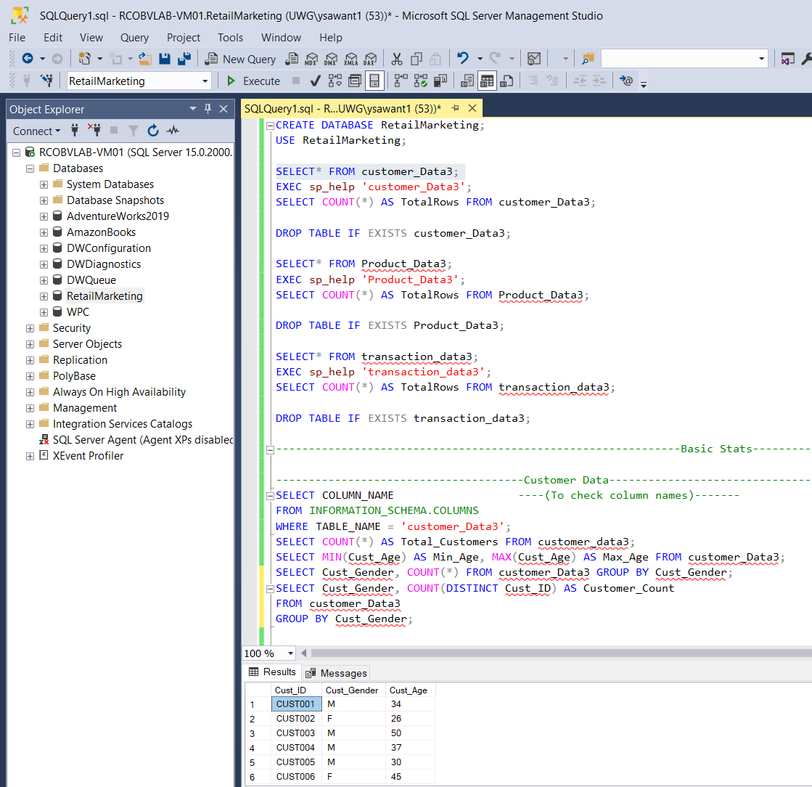
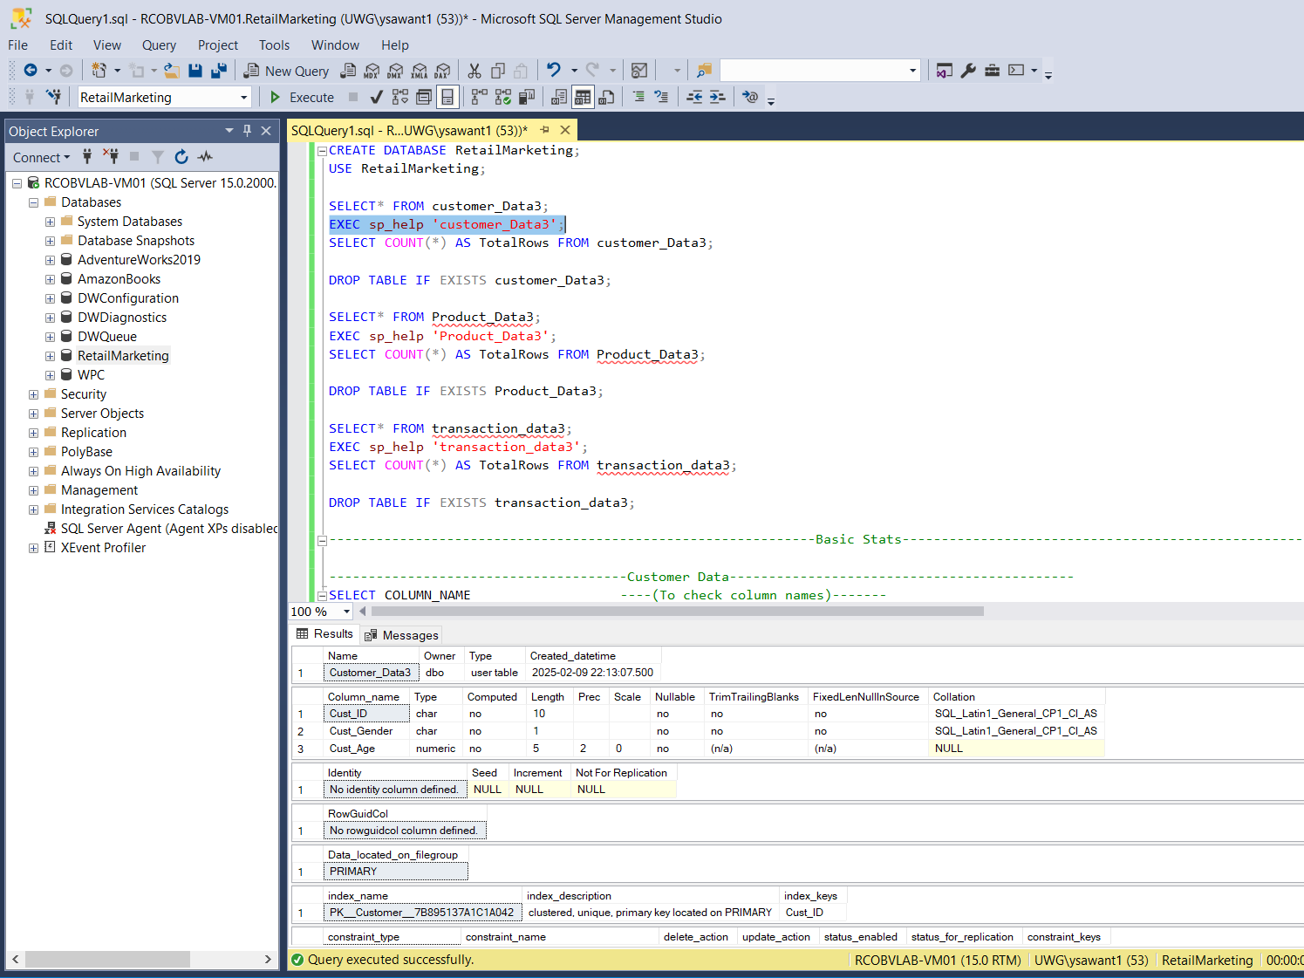
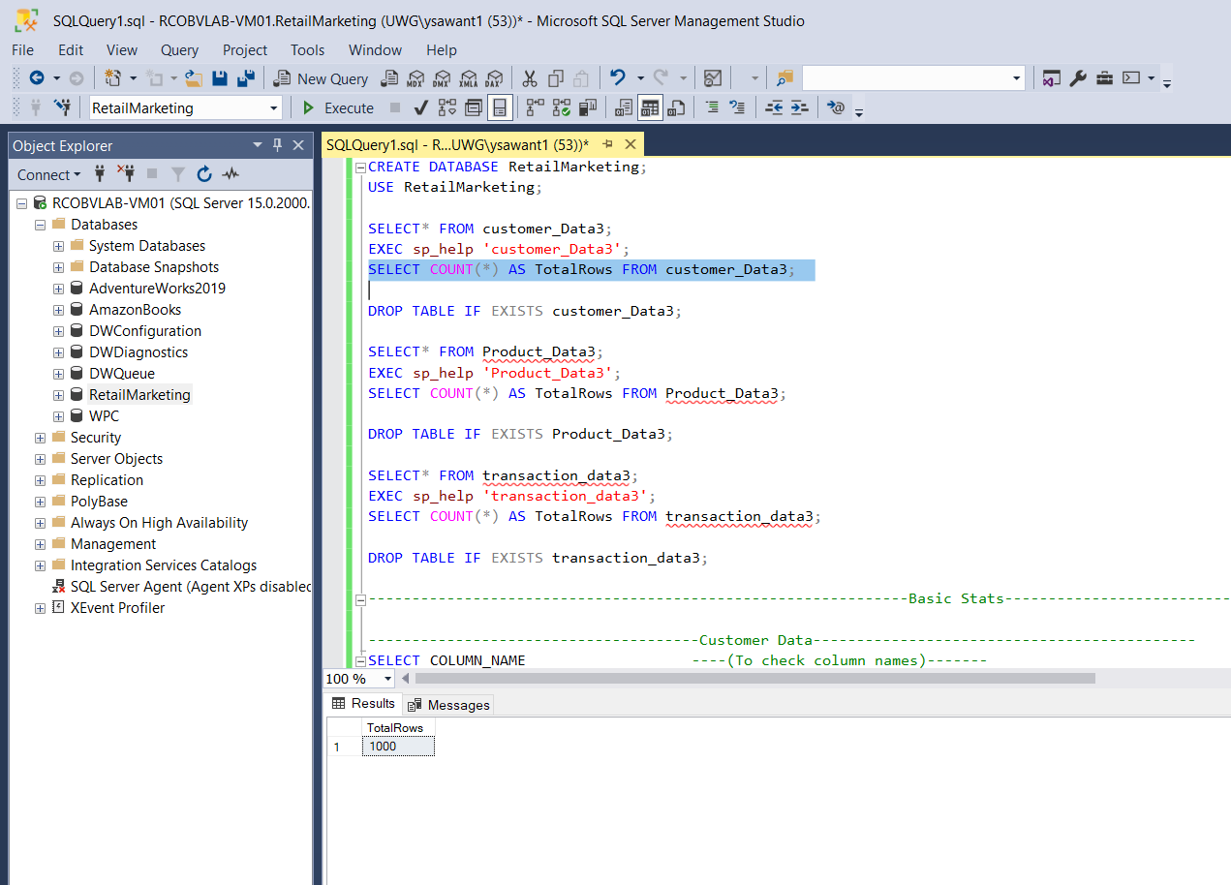
Output for Customer Data :

Slide 8
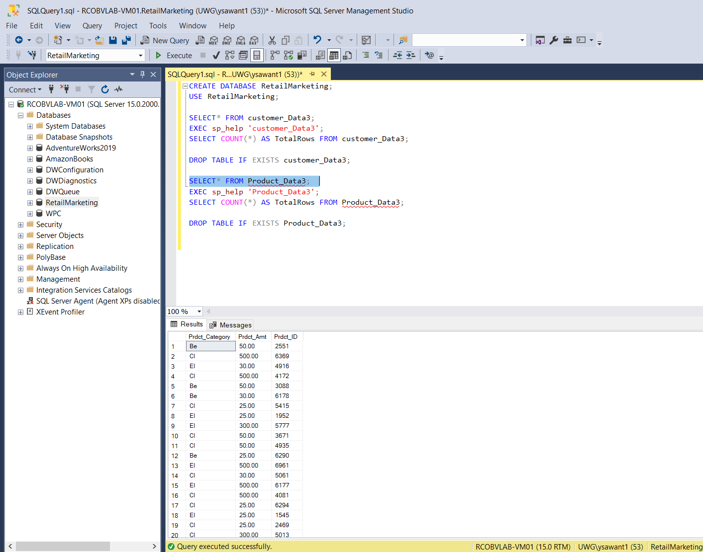
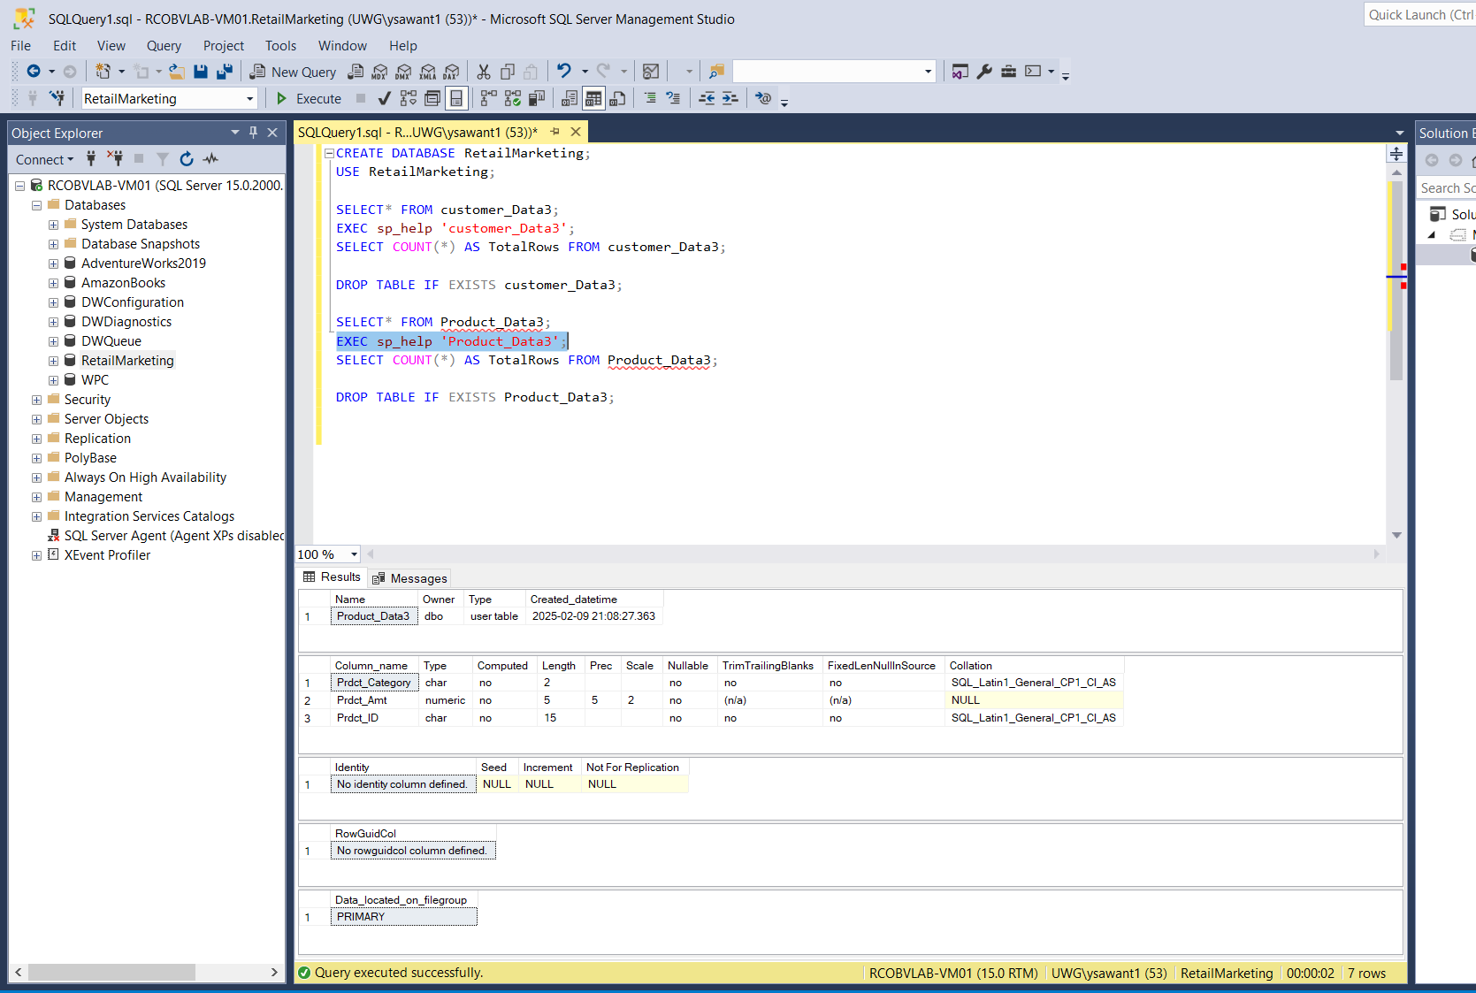
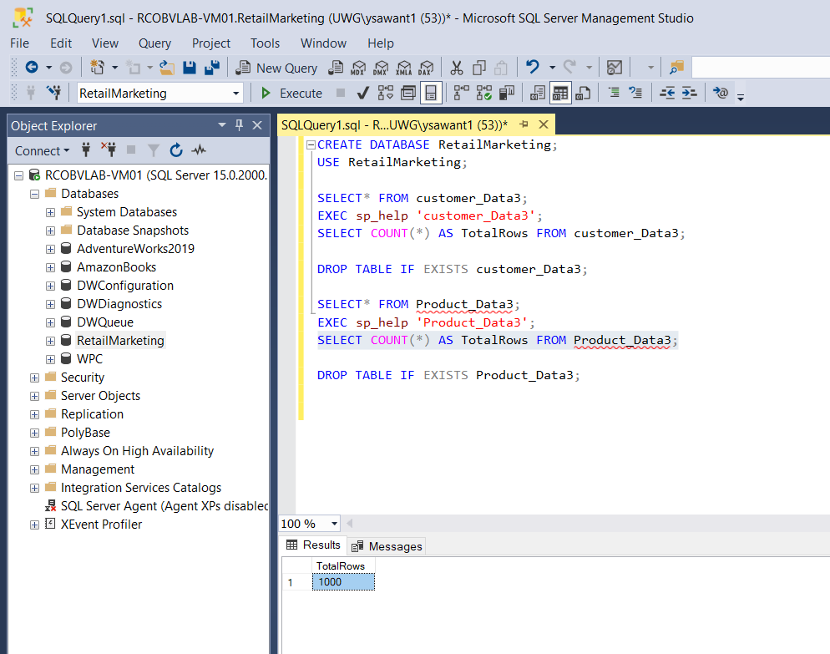
Output for Product Data :

Slide 9
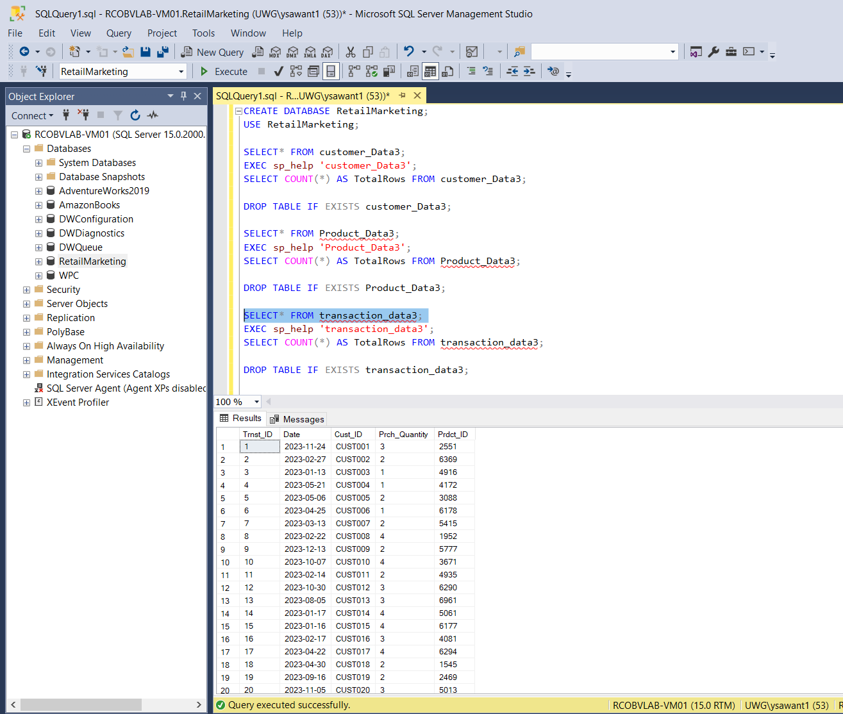
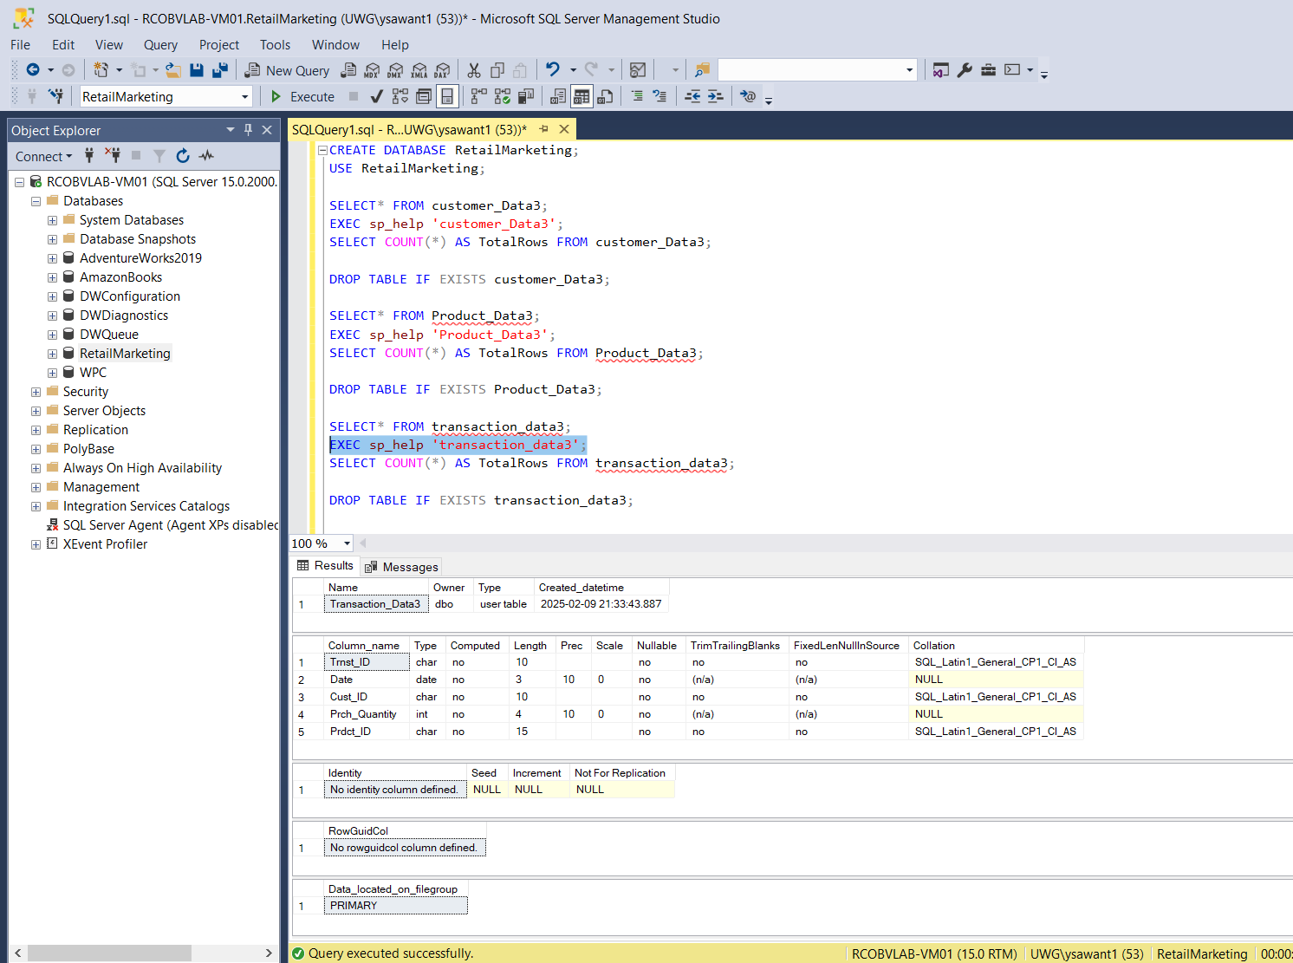
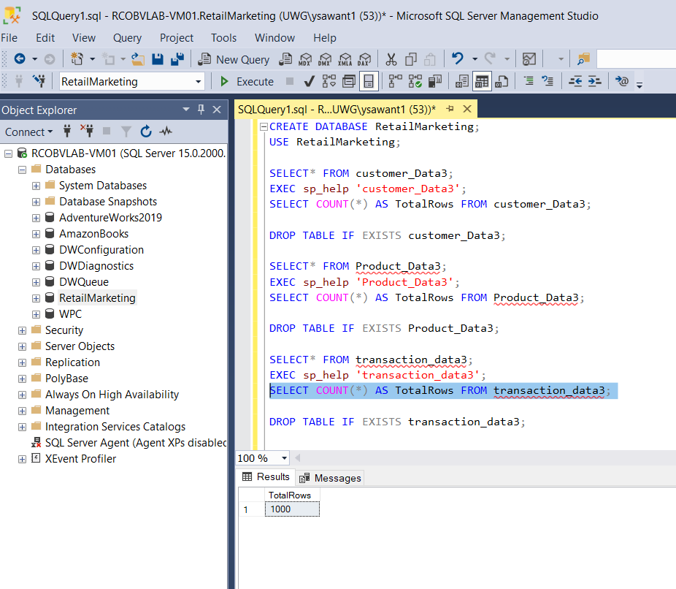
Output for Transaction Data :

Slide 10
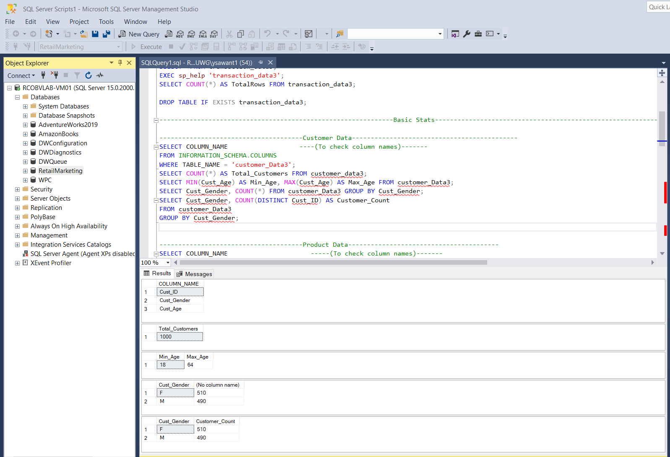
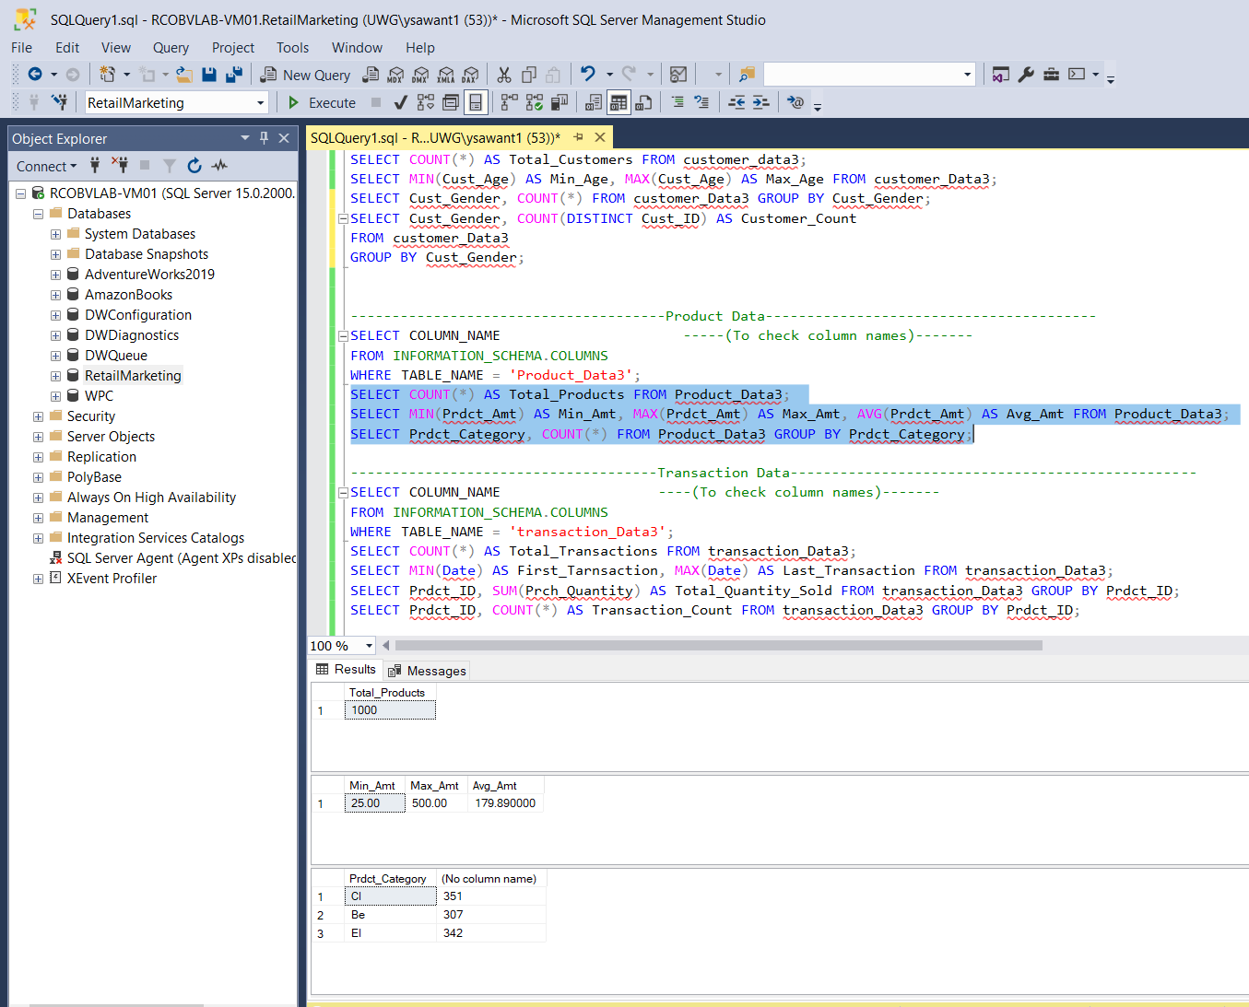
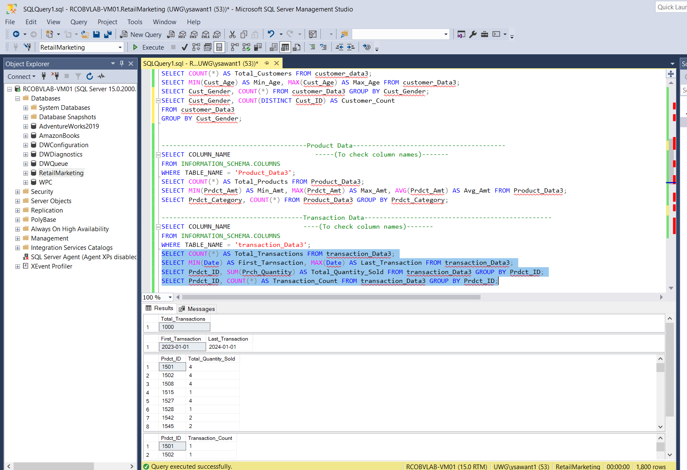
Output of Basic Stats : Count, Min, Max
Customer
Product
Transaction

Slide 11
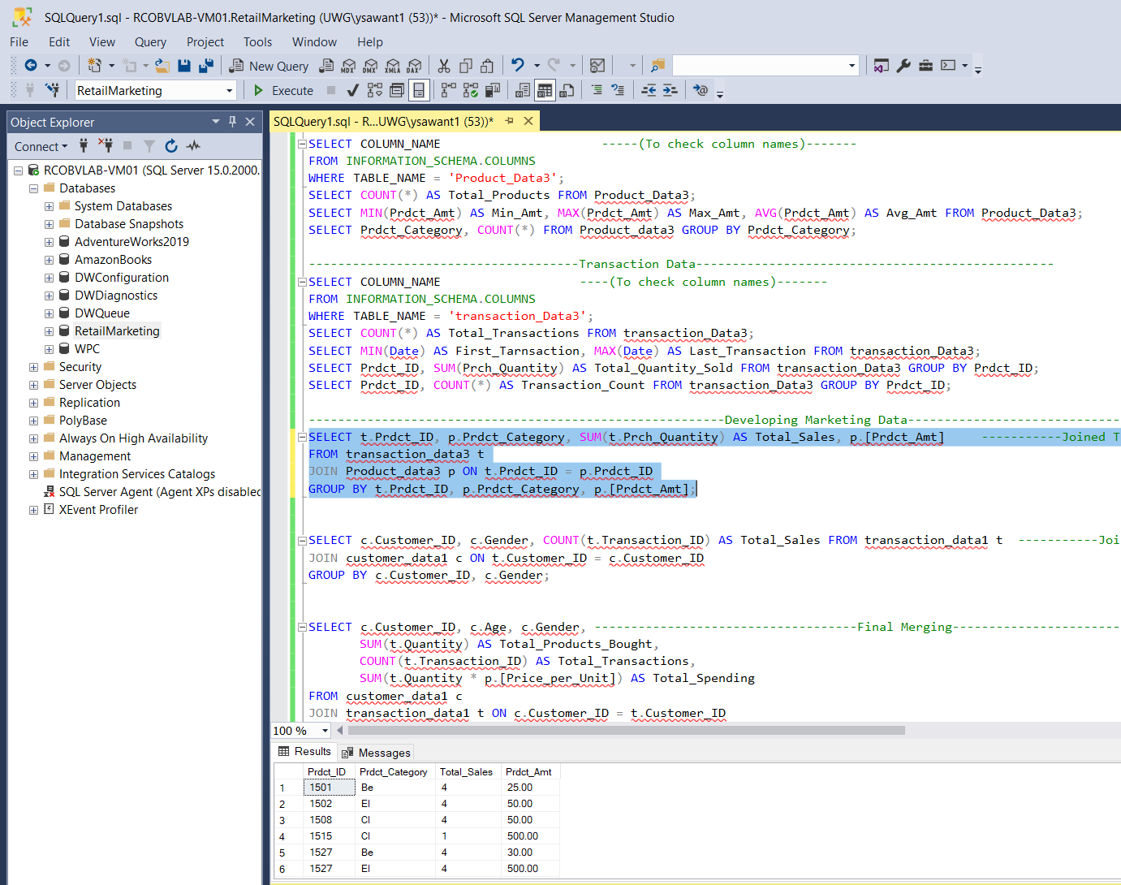
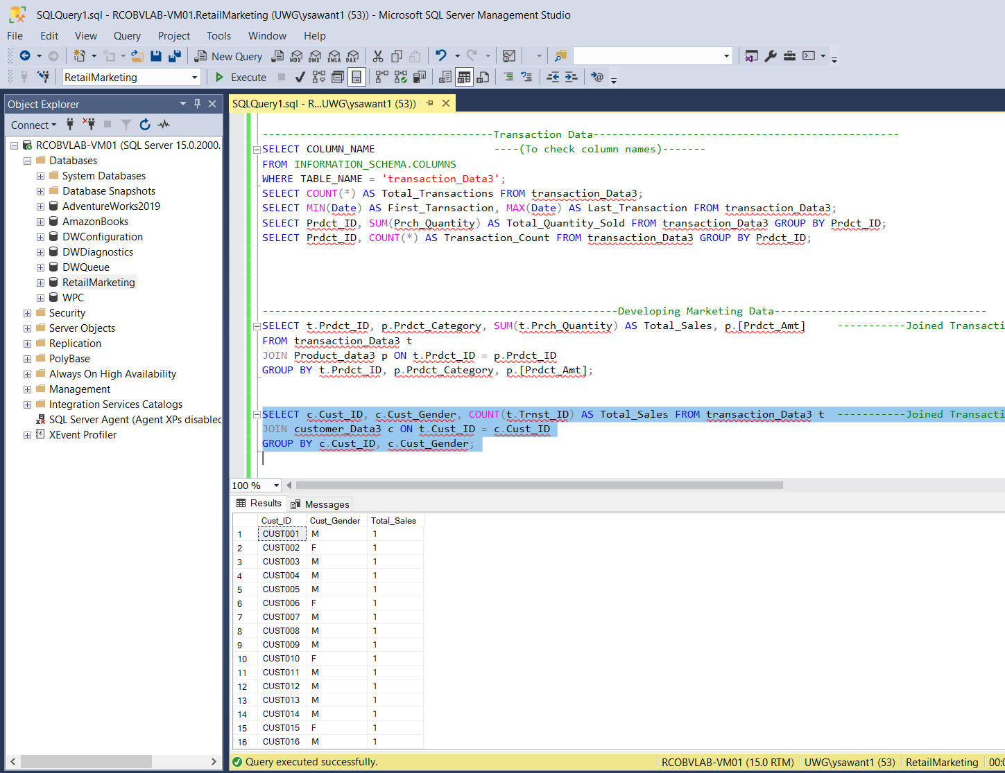
Output : Developing Marketing Data
Joined Transaction Data with Product Data
Joined Customer Data with Transaction Data

Slide 12
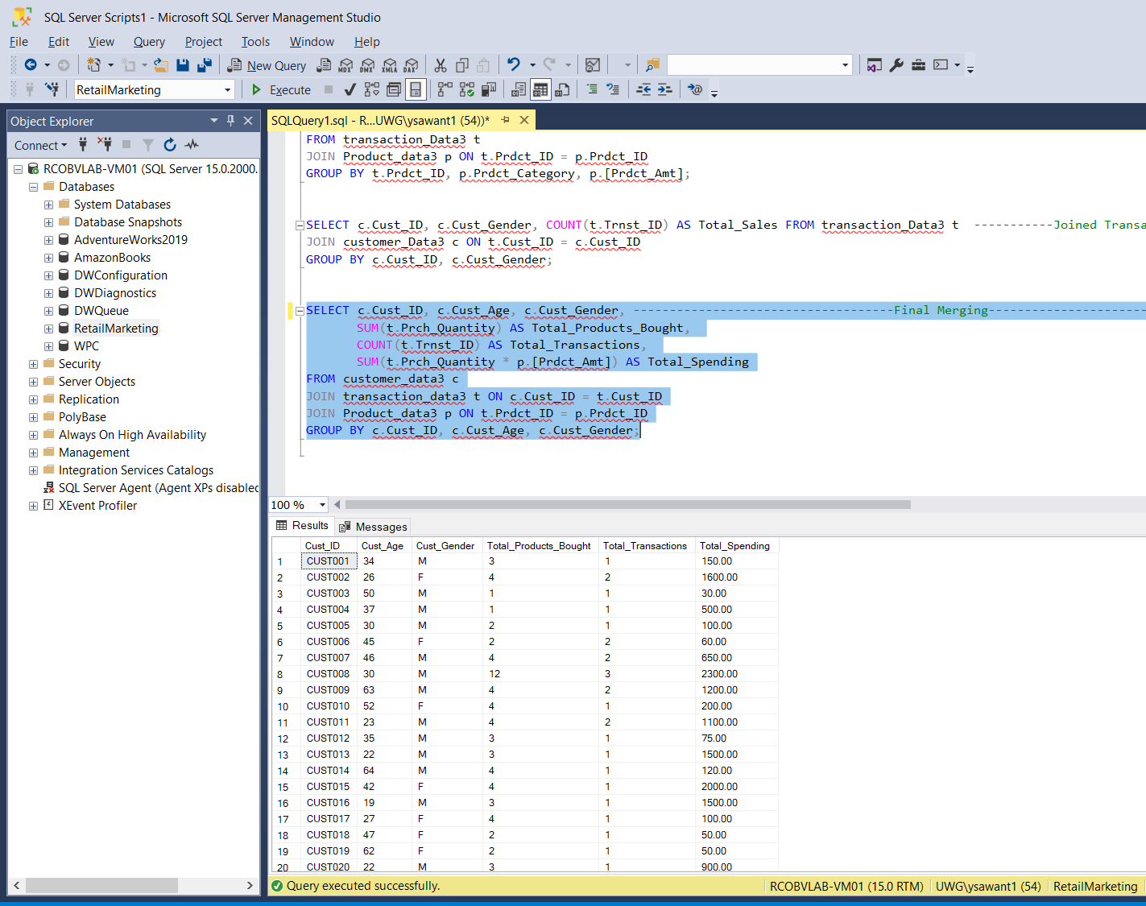
Final Result : Merged tables

Slide 13
Conclusion :

